Slide 1

Road Accident ANALYSIS

Slide 2
Project Description
This project has a goal to analyse data about traffic accidents and discover patterns and insights about the injuries. We'll be using important markers called Key Performance Indicators (KPIs) to understand how severe and impactful the accidents were. These indicators include things like the total number of people injured based on how serious the accidents were, the types of vehicles involved, the characteristics of the roads, and other factors.

Slide 3
Activities
The following activities were followed during the project:
Data Cleaning: In this step, the data was cleaned by removing inconsistencies, errors, and duplicates. The goal was to ensure the accuracy and reliability of the data for further analysis. Example- Replaced Fetal to Fatal in Accident_Severity Column, Replaced Auto traffic sig to Auto traffic signal in Junction_Control Column
Data Processing: New columns were created to organize, sort, and filter the data for extracting meaningful insights. Example- Add a column of Month by applying formula =TEXT(B2,"MMMM"), Add a column of Year by applying formula =TEXT(B23,"MMMM")
Data Analysis: Various statistical methods were applied to derive valuable insights from the data.
Data Visualization: Excel was utilized as a visualization tool to create attractive charts, graphs, and interactive visuals for presenting the data in an easily understandable manner.
Dashboard Creation: Finally, a dashboard was built in Excel by incorporating slicers and timelines, enabling users to interact with the data and explore different perspectives.

Slide 4
Tech-Stacked used
I used Microsoft Excel to analyse the data and create visual dashboards for a clearer understanding.

Slide 5
Insights and Result
Create a road accident dashboard for the years 2021 and 2022 so that we can have insight into the requirements.
1. First Primary KPI:
Total Casualties: The Sum of casualties were taken after the accident.
2. Second Primary KPI:
Total Casualties and percentage of total with respect to accident severity and maximum casualties by type of vehicle
Sum of Number_of_Casualties
134613

Slide 6
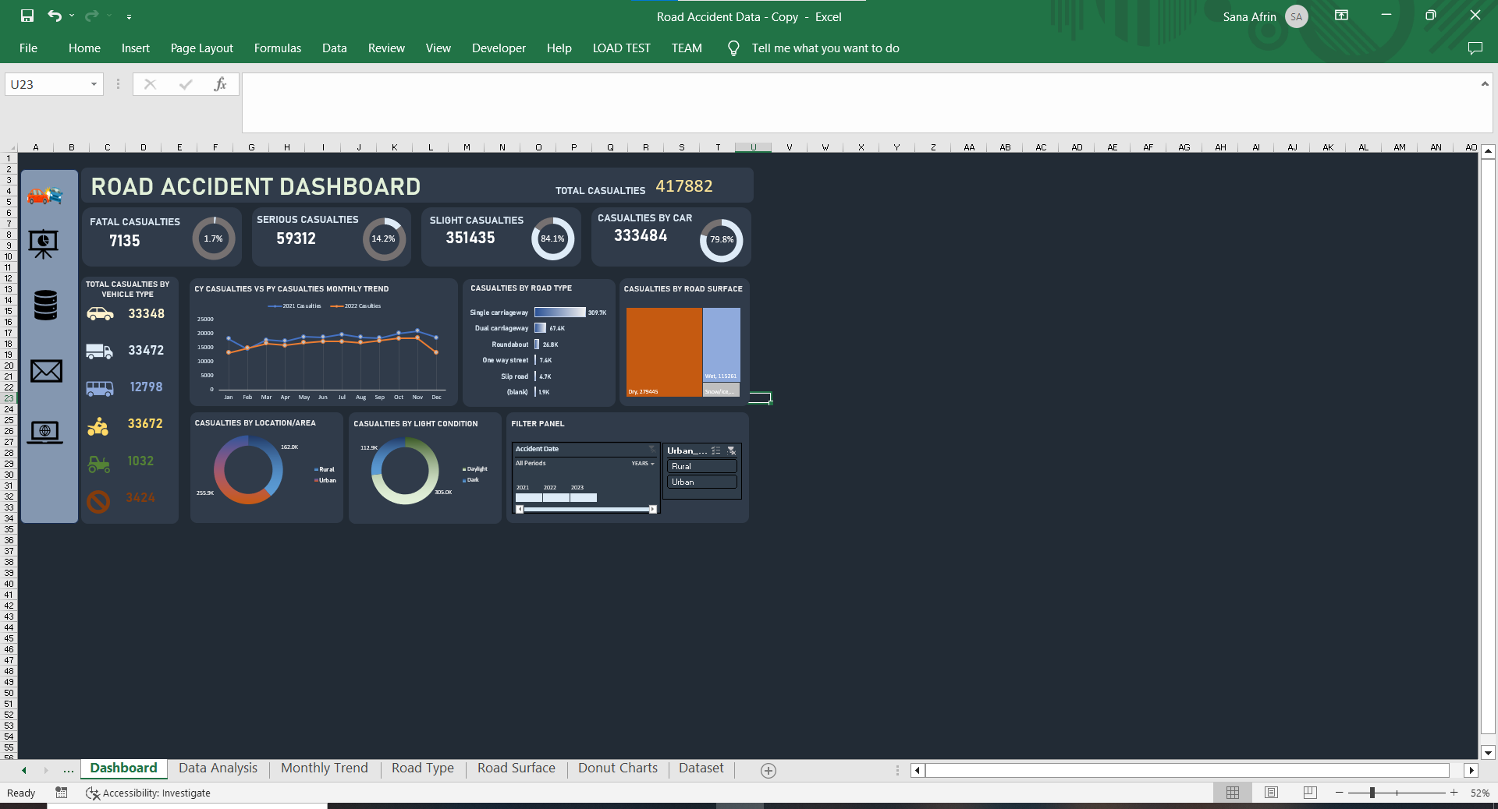
3. Secondary KPI’s
Total casualties with respect to vehicle types
Monthly trend showing the comparison of casualties for the Current Year and the Previous Year
Vehicle Type | Sum of Number_of_Casualties
Agricultural vehicle | 371
Cars | 107637
Bus | 3587
Van | 10676
Bike | 11136
Other | 1206
Grand Total | 134613

Slide 7
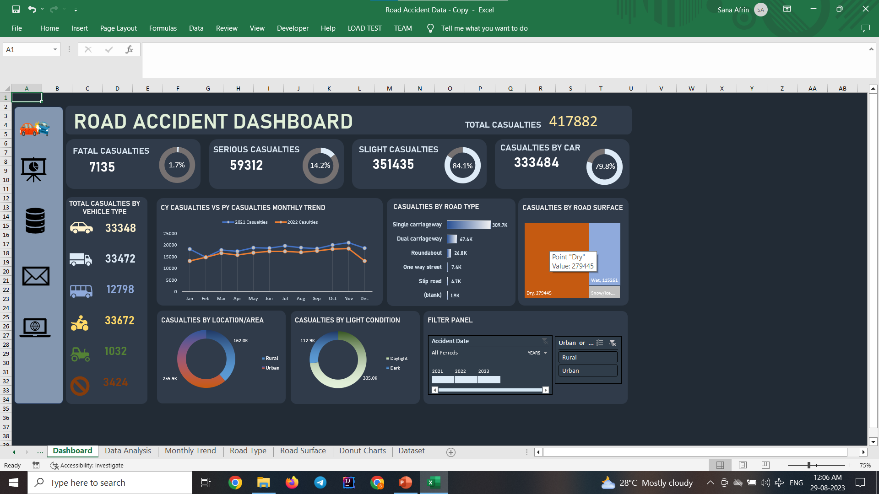
Maximum casualties by road type
Distribution of total casualties by road surface
Road Type | Sum of Number_of_Casualties
Single carriageway | 309.7K
Dual carriageway | 67.4K
Roundabout | 26.8K
One way street | 7.4K
Slip road | 4.7K
(blank) | 1.9K
Grand Total | 417882
Road Surface | Sum of Number_of_Casualties
Dry | 279445
Wet | 115261
Snow/Ice | 22780
(blank) | 396
Grand Total | 417882

Slide 8
Relation between casualties by area/location and by day/night
AREA | Sum of Number_of_Casualties
Rural | 162.0K
Urban | 255.9K
Grand Total | 417882
LIGHT CONDITION | Sum of Number_of_Casualties
Daylight | 305.0K
Dark | 112.9K
Grand Total | 417882

Slide 9
Key Insights:
Total Casualties that took place after the accident is 417883
Maximum Casualties happened by Car (333485) which is 79.8% of total Casualties and minimum by others 3424
Total Casualties that took place in the Year 2021 & 2022 is 222146 and 195737.
Maximum Casualties happened in the month of November 2021 and Minimum in February 2021.
Maximum Casualties happened in the month of November 2022 and Minimum in January 2022.
Maximum Casualties by Single Carriageway road type and Minimum by Slip road.
Highest Distribution of total casualties on Dry road surfaces.

Slide 10
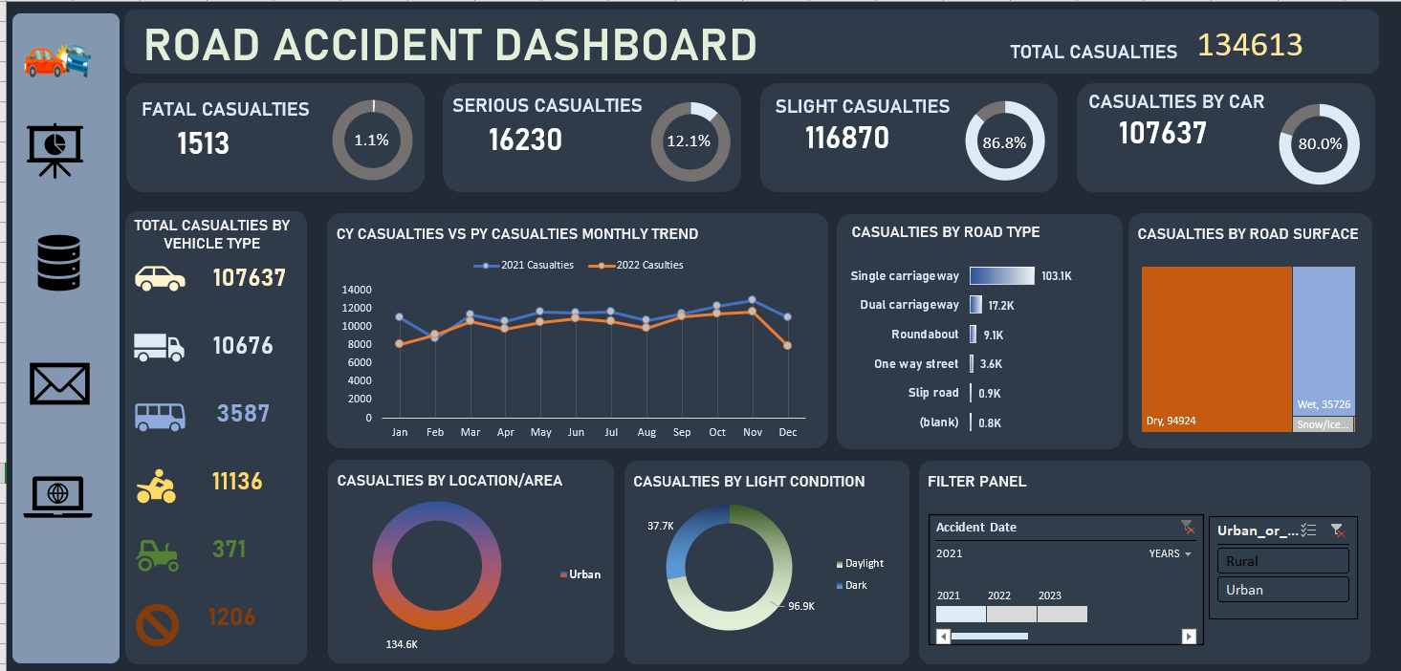
Dashboard

Slide 11
THANK YOU!!!

